Slide 1
Film and Theatre: an Active Audience
Week Two Lecture

Slide 2
Agenda
This Week
Seminar Presentations
Lecture
Discussion
Next Week
Film Review assigned
Lecture
Discussion

Slide 3
Genre Conventions
“Genre refers to the categorization of narrative films by the stories they tell and the ways they tell them”(Barsam&Monaham 82)
Western
Science fiction
Musical
Gangster
Action
Biopics
Thrillers
Romances
Romantic comedies
Fantasy

Slide 4
Non-Genre Films
“Films that tell stories and employ styles that do not fit neatly into any existing genre template” (82)
Recent examples:
All the Money in the World (Ridley Scott)
Coco (Lee Unkrich, Adrian Molina)
Molly’s game (Aaron Sorkin)
Ladybird (Greta Gerwig)

Slide 5
Invisibility and Cinematic Language
Movies move too fast for the viewer to consciously notice and consider all aspects of the film.
Filmmakers created a film grammar (the cinematic language) to help the viewer absorb and interpret the information intuitively and instantly.
Examples:
The fade-out/fade-in (dissolve)
A low-angle shot
Cutting on action

Slide 6
Dissolve
https://www.filmpolicereviews.com/features/7-cinematic-examples-of-the-dissolve

Slide 7
Cultural Invisibility
Filmmakers often reinforce viewers’ shared belief systems – they give viewers what they want.
Viewers could be blind to the implied political, cultural, and ideological messages that help make the movie so appealing.
Some films resist common cultural values.

Slide 8
Implicit and Explicit Meaning
“An implicit meaning, which lies below the surface of the movie’s story and presentation, is closest to our everyday sense of the word meaning. It is an association, connection, or inference that a viewer makes on the basis of the explicit meaning available on the surface of the movie” (Barsam&Monaham 12).

Slide 9
Cultural and Formal Analysis of the Star Wars series
Star Wars (1977) George Lucas
The franchise consists of four sequels and five prequels, the latest Episode IV - Solo – A Star Wars Story (2018)
Over $8 billion in worldwide box office
The viewer experiences familiar characters’ physical and emotional development over an extended period of time;
The stories span generations;

Slide 10
Star Wars
A repetition of the character types, story formulas, settings, and themes;
A combination of the unpredictable and the unexpected;
The stories rooted in the folktales, myths, and religions of multiple cultures: the hero’s journey archetype.

Slide 11
Star Wars
For the Jedi knights, Lucas blended the traditions of knighthood and chivalry found in medieval Europe with those of the Japanese samurai.
He created “a timeless cultural collage.”
“We see ourselves reflected in the archetypical conflicts and characters the stories present.”
The binary good-versus-evil struggle
(From Looking at Movies an Introduction to Film, by Richard Barsam and Dave Monahan, 2019)

Slide 12
What Genre is Star Wars?

Slide 13
Week 2 Discussion Questions
Define “cultural invisibility.”
What means can filmmakers use to reinforce viewers’ shared belief systems?
Can you think of a film/TV show that portrays people from a particular social class negatively?
How do film genres come about?
Can you think of some genre-identified stars?
What are the genre conventions?
Give your examples of a film(s) that fit(s) into each given genre convention.
How do genres evolve?
Define the basic approaches to studying film history.

Slide 14
Henry Jenkins
http://www.youtube.com/watch?v=ibJaqXVaOaI

Slide 15
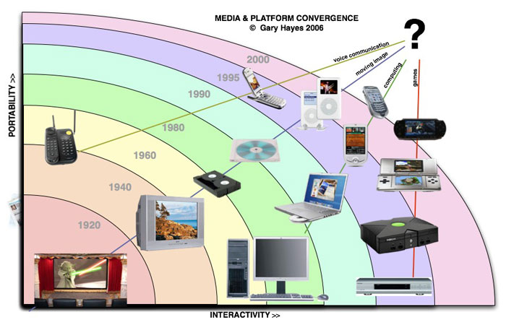
Media Convergence

Slide 16
Dangers of Technology
Loss of control over technology
Artificial intelligence
Addiction to technology
Obsession with gadgets
Loss of our humanity

Slide 17
The Matrix: Transmedia Storytelling
The viewer needs to do his/her homework
“The Matrix is entertainment for the age of media convergence, integrating multiple texts to create a narrative so large that it cannot be contained within a single medium” (Jenkins 97).

Slide 18
Transmedia Storytelling cont.
Economic motivation behind transmedia storytelling
the goal is “the construction and enhancement of entertainment franchises to create strong emotional attachments” (Jenkins 106).
The Kid’s Story
http://www.youtube.com/watch?v=bJRh8n0fQVg&feature=related

Slide 19
The Second Renaissance by Mahiro Maeda
One of the nine Animatrix films
http://www.youtube.com/watch?v=cTLMjHrb_w4&feature=endscreen&NR=1

Slide 20
Licensing versus “Co-creation”
the viewer does not want simple repetition of “the same printing of a Star Trek logo on so many widgets.” They want new creative work to provide new experiences and insights.
Licensing does not allow new character background, or plot development,
It offers “duplicate experiences” 107
In co-creation “the companies collaborate from the beginning to create content… allowing each medium to generate new experiences for the consumer and expand points of entry into the franchise” 107

Slide 21
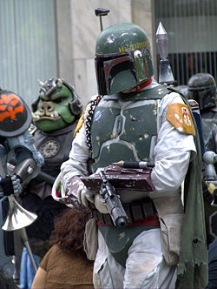
Boba Fett
Boba Fett

Slide 22
Collaborative Authorship
Short animated films were made after the Matrix films.
Warchovski brothers looked for different established animators with their own visual styles to create their shorts.
They did not simply subcontract or license work; they wrote and directed the content of the game.
The Art of World-Making
“The Wachovski brothers built a playground where other artists could experiment and fans could explore” (Jankievic 115).
Recurring motives and contextualizing devices so that the whole becomes more convincing.

Slide 23
The Collective Authorship at Work: the Matrix Franchise
Enter the Matrix Documentary: Part 1 and 2
http://www.youtube.com/watch?v=oXrYNTnwv34
http://www.youtube.com/watch?v=N25z289r0Cc&feature=related
The new characters in the franchise do not need to be introduced; they are broad archetype: heroes and villains.

Slide 24
Monomyth The Hero with a Thousand Faces
“A hero ventures forth from the world of common day into a region of supernatural wonder: fabulous forces are there encountered and a decisive victory is won: the hero comes back from this mysterious adventure with the power to bestow boons on his fellow man” (Joseph Campbell 30).

Slide 25
Additive comprehension
“Additive comprehension” is about creators trying to shape our interpretations.
The death of Morpheus in the game was used to motivate players’ missions within the game world.
The case of the origami unicorn in the Director’s cut of Blade Runner

Slide 26
The Aesthetic Value of The Matrix films?
Jenkins’ argument is that “we do not yet have very good aesthetic criteria for evaluating works that play themselves across multiple media” 99
Do you agree with most critics that the Matrix is a failure because the later sequels are incoherent and not enough self-contained and “the games are too dependent on the film and did not offer sufficiently new experiences to players”? (Jenkins 98)

Slide 27
Storytelling
Do you agree with some critics that talk about “the collapse of storytelling,” or do you believe that we should rather talk about the “emergence of new story structures,” which expand “the range of narrative possibility” and do not follow “one single path with a beginning, middle and end”? (Jenkins 121)

Slide 28
Provide your own examples of films that have a non-linear plot
Discuss films that
do not follow “one single path with a beginning, middle and end” (Jenkins 121)
expand “the range of narrative possibility”
Robert Altman’s Short Cuts…..
“While helicopters overhead spray against a Medfly infestation a group of Los Angeles lives intersect, some casually, some to more lasting effect. Whilst they go out to concerts and jazz clubs and even have their pools cleaned, they also lie, drink, and cheat. Death itself seems never to be far away, even on a fishing trip…”(The Internet Movie Database).

Slide 29
Run Lola Run
https://www.youtube.com/watch?v=ppeZQ8inevE

Slide 30
Night on Earth Jim Jarmusch
http://www.youtube.com/watch?v=p9YI7wUFl0w&feature=related

